Slide 1

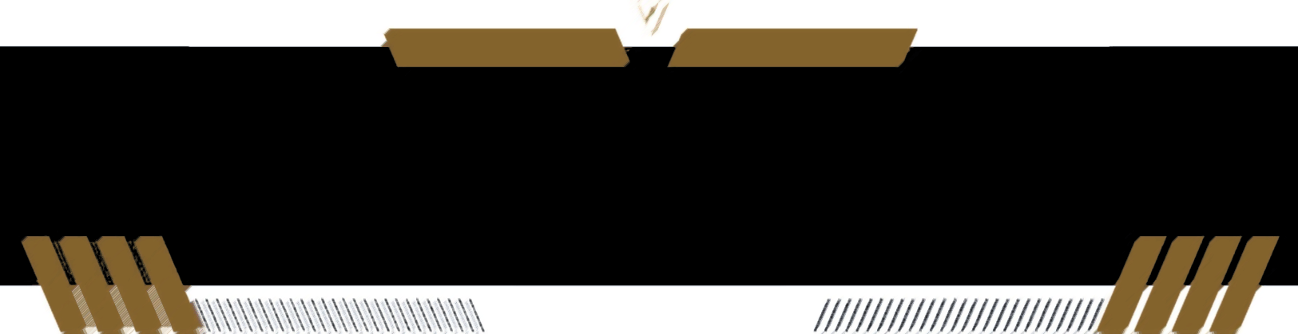
Implementation Progress Report (TriDCCS-SVM: A Hybrid Model for Satellite Image Classification)
Faculty of Science and Technology (FST)
Presented by: YOUSEF H S ALSAFADI
Supervised by: Professor. Rosalina Abdul Salam
2025

Slide 2

Introduction & Background
This work presents the implementation of TriDCCS-SVM, a hybrid model designed to enhance the classification accuracy of high-resolution satellite images. The model combines three deep convolutional neural networks (ResNet50, DenseNet169, and EfficientNetB0) for feature extraction and integrates a Support Vector Machine (SVM) for classification.
The implementation focuses on:
1. Data preprocessing: Cleaning datasets, resizing images, and handling invalid entries.
2. Feature Extraction: Extracting deep features using three pretrained CNN architectures.
3. Feature Fusion: Combining features from all three networks into a high-dimensional vector.
4. Classification: Training SVM on the fused features to perform the final classification.
5. Evaluation: Achieving high accuracy and outperforming previous studies.
Key results: Achieved high classification accuracy on benchmark datasets:
- UC Merced: Achieved 97.86% accuracy. - SIRI-WHU: Achieved 96.25% accuracy.

Slide 3
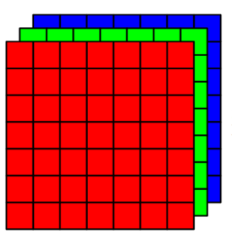
RGB High-Resolution Satellite Images
Data Collection
Data Collection
Collect and prepare satellite images from benchmark datasets (SIRI-WHU and UC Merced).
Data Preprocessing Cleaning datasets, resizing images, normalization, splitting datasets, converting to specific modes, and handling invalid entries.
Feature Extraction Using ResNet50, DenseNet169, and EfficientNetB0 to extract deep features.
Feature Fusion Concatenate extracted features into a single high-dimensional vector
(4992 dimensions per image ).
Classification Train an SVM classifier with RBF kernel on the fused features for final classification.
Model Evaluation Accuracy, F1-score, Confusion Matrix, and visualization of results.
Data Preprocessing
ResNet 50
EfficientNet
Feature Extraction
DenseNet 169
Fusion of Features Concatenation
Extracted Features
Train SVM Classifier Uses combined features for classification with optimized gamma and penalty parameters.
Figure 1: Framework Flow
Figure 2: Architecture of TriDCCS-SVM

Slide 4
Structure
implementation-code-tridccs-svm/
|
|-- datasets/ # Input datasets (SIRI-WHU, UC Merced)
| |-- siri_whu/
| | |-- agriculture/
| | |-- commercial/
| | +-- ...
| +-- uc_merced/
| |-- airplane/
| |-- buildings/
| +-- ...
|
|-- notebooks/ # Jupyter notebook with implementation
| +-- tridccs_svm_yousef.ipynb
| -- code-pdf /
| +-- tridccs-svm-yousef-alsafadi.pdf
| -- code-html /
| +-- tridccs-svm-yousef-alsafadi.html
|
|-- outputs/
| |-- models/ # Trained SVM models
| |-- processed/ # Extracted and fused features
| |-- results/ # Evaluation metrics and CSV reports
| |-- visualizations
|
|| -- Implementation Progress Report/
| +-- Presentation.pptx
|
|-- requirements.txt # Python dependencies
+-- README.md # Project documentation

Slide 5
Requirements
This implementation was developed and tested with:
Python 3.12.7
TensorFlow 2.19.0
Keras
scikit-learn
OpenCV
NumPy, Pandas
Matplotlib, Seaborn
tqdm
joblib

Slide 6
System Requirements
This implementation can run on a standard desktop or laptop. For better performance during feature extraction and model training, the following specifications are recommended:
Processor (CPU): Quad-core Intel i5 / AMD Ryzen 5 or higher
RAM: Minimum 8 GB (Recommended: 16 GB or more)
GPU (Optional): NVIDIA GPU with CUDA support (Recommended: 4 GB VRAM or higher, e.g., GTX 1650, RTX series)
Disk Space: Minimum 5 GB free for datasets and outputs
Operating System: Windows 10/11, Ubuntu 20.04+, or macOS 11+
> Note: GPU acceleration is optional but strongly recommended for faster CNN feature extraction. Without GPU, the process may take longer.

Slide 7
Datasets Overview
The approach was tested on two benchmark datasets:
1. SIRI-WHU Dataset
Includes 2,400 images
12 land-cover classes (200 images per class)
Each image size: 200×200 pixels.
Example classes: agriculture, commercial, harbor, meadow, residential, water.
2. UC Merced Land Use Dataset
Includes 2,100 images
21 land-use classes (100 images per class)
Each image size: 256×256 pixels.
Example classes: airplane, beach, forest, parking lot, golfcourse, freeway.
> Both datasets are split into 80% training and 20% testing, maintaining class balance.

Slide 8
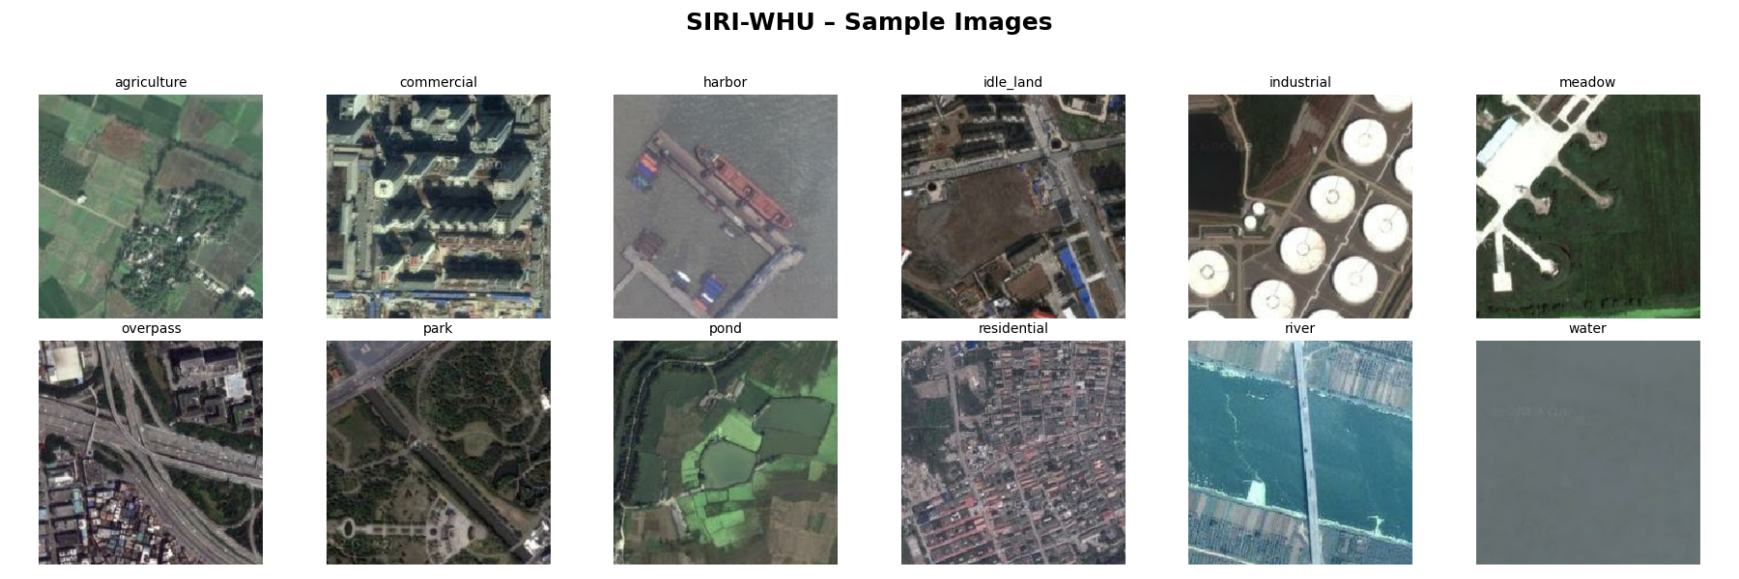
SIRI-WHU Dataset – Sample Images
Figure 3: Sample images from the SIRI-WHU Dataset

Slide 9
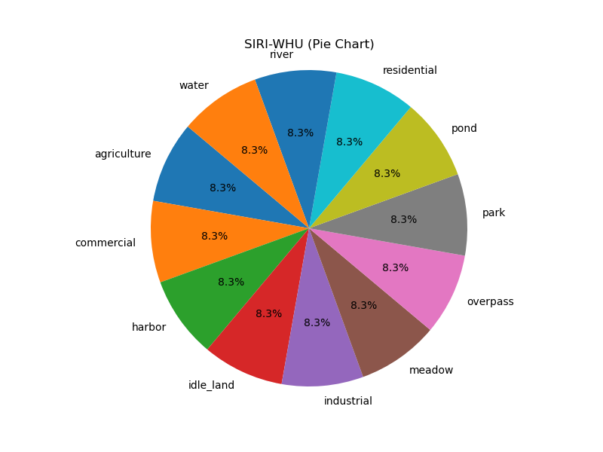
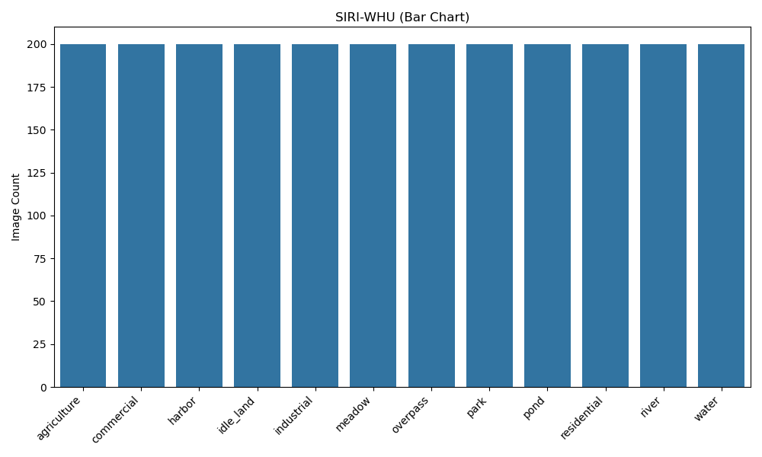
SIRI-WHU Dataset- Pie Chart & Bar Chart
Figure 4: Class distribution of the SIRI-WHU dataset visualized using pie and bar charts

Slide 10
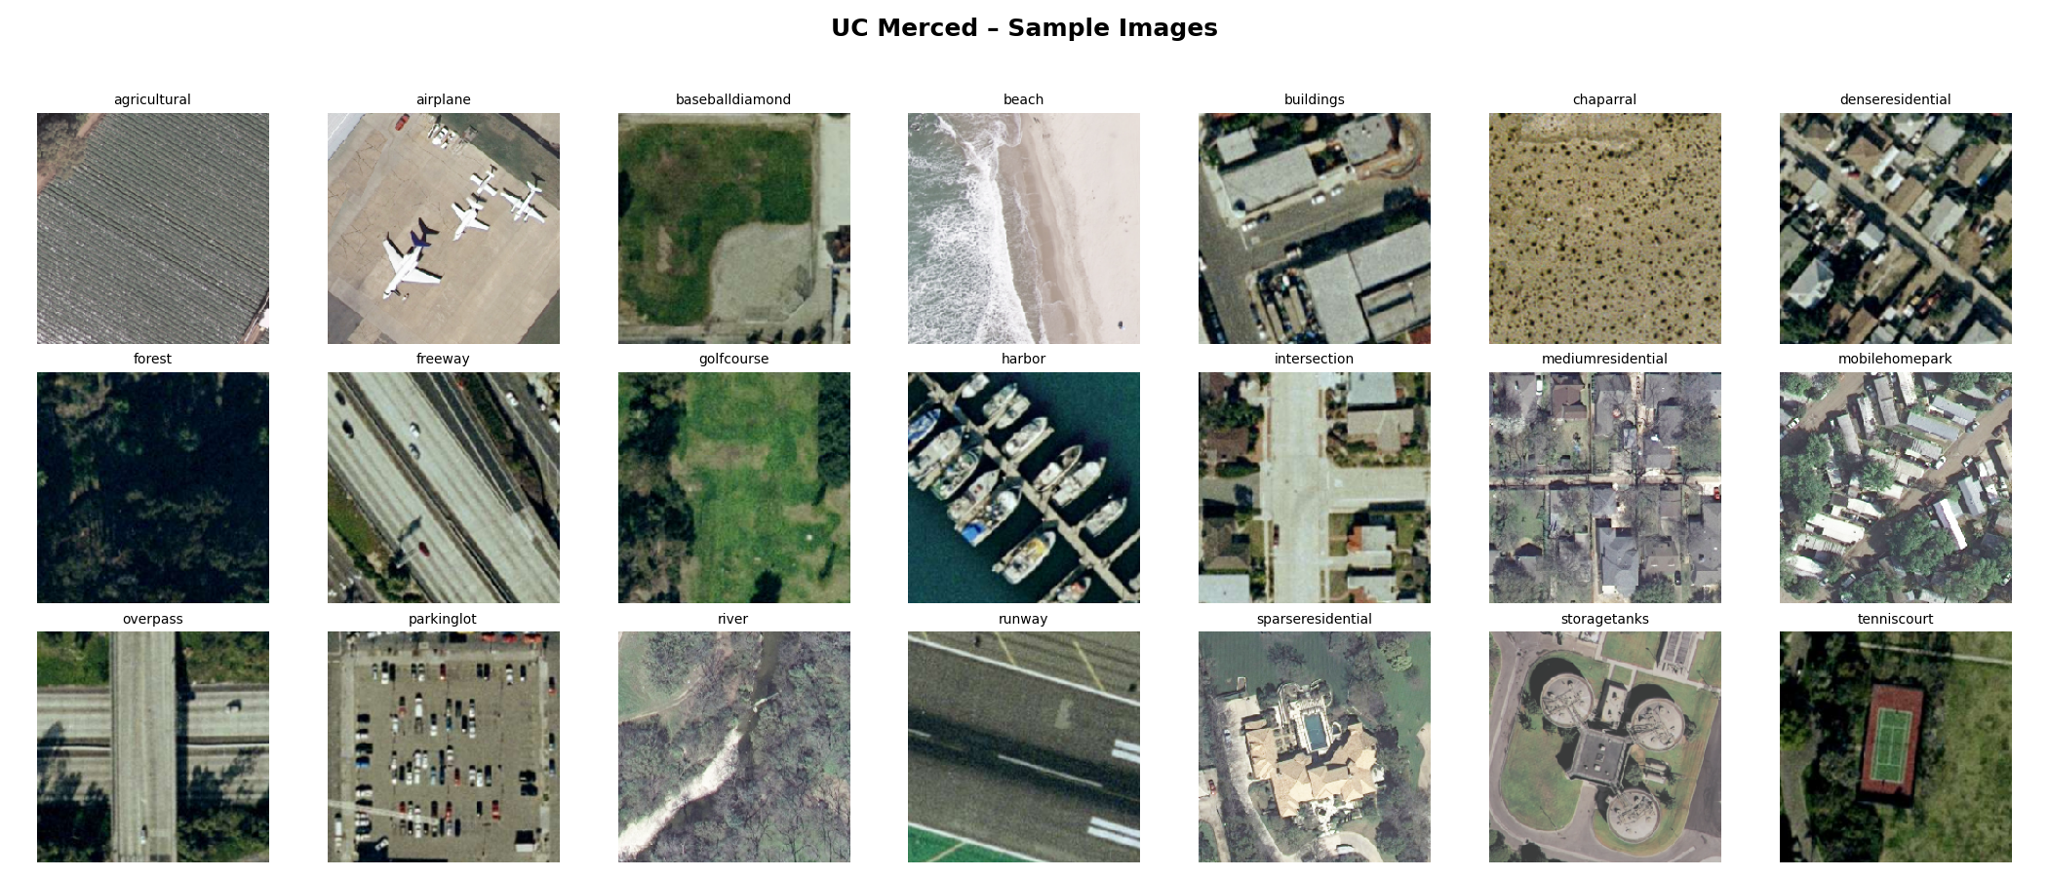
UC Merced Land Use Dataset - Sample Images
Figure 5: Sample images from the UC Merced Land Use Dataset

Slide 11
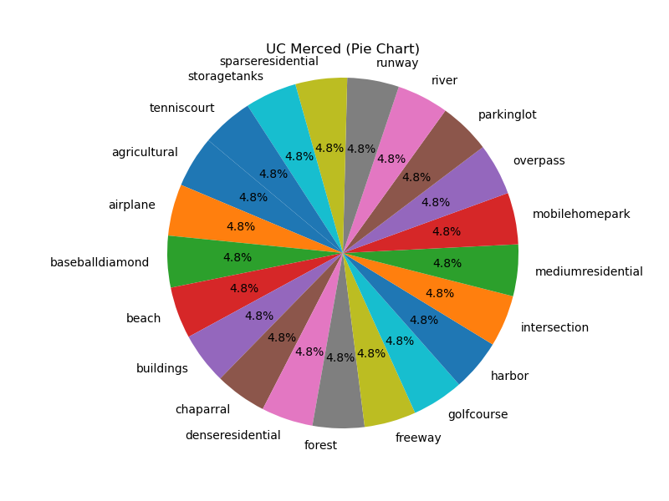
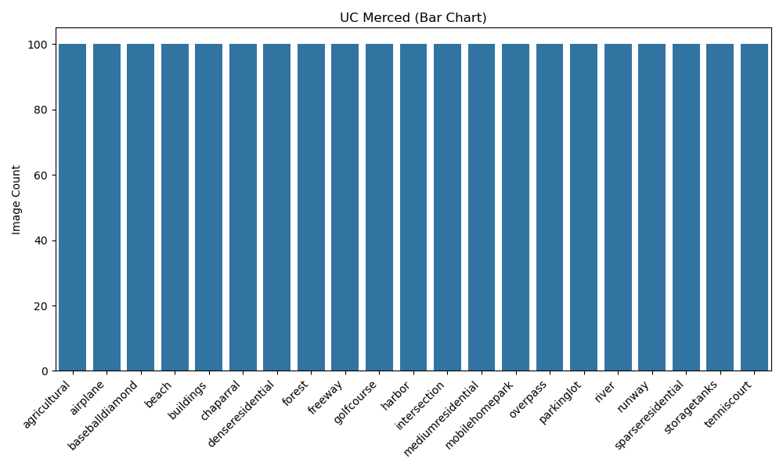
UC Merced Land Use Dataset - Pie Chart & Bar Chart
Figure 6: Class distribution of UC Merced Land Use Dataset visualized using pie and bar charts

Slide 12
Importing Required Libraries
After Installing Python Packages, all necessary Python libraries are imported to support data handling, image processing, deep learning, machine learning, and visualization tasks.
Key Libraries Imported:
Standard Libraries: os, sys, platform, subprocess, cpuinfo.
Data Processing: numpy, pandas, joblib, psutil.
Image Processing: cv2, PIL.
Deep Learning: tensorflow, keras.
Machine Learning: scikit-learn, xgboost.
Visualization: matplotlib, seaborn.
Utilities: tqdm, IPython.display.
> These libraries provide all the tools required for the implementation workflow.

Slide 13
Displaying System Specifications
System Specifications
----------------------------------------
[CPU Information]
Processor Name : 12th Gen Intel(R) Core(TM) i7-1280P
Physical Cores : 14
Logical Cores : 20
Max Frequency (MHz) : 2000.00
Current Frequency : 2000.00
[Memory (RAM)]
Total RAM (GB) : 15.71
Available RAM (GB) : 5.67
RAM Usage (%) : 63.9%
[Operating System]
System : Windows 11
Machine Architecture: AMD64
[GPU Information]
No NVIDIA GPU detected or 'nvidia-smi' not available.
> This output confirms that the system has adequate CPU and RAM resources for running the implementation.

Slide 14
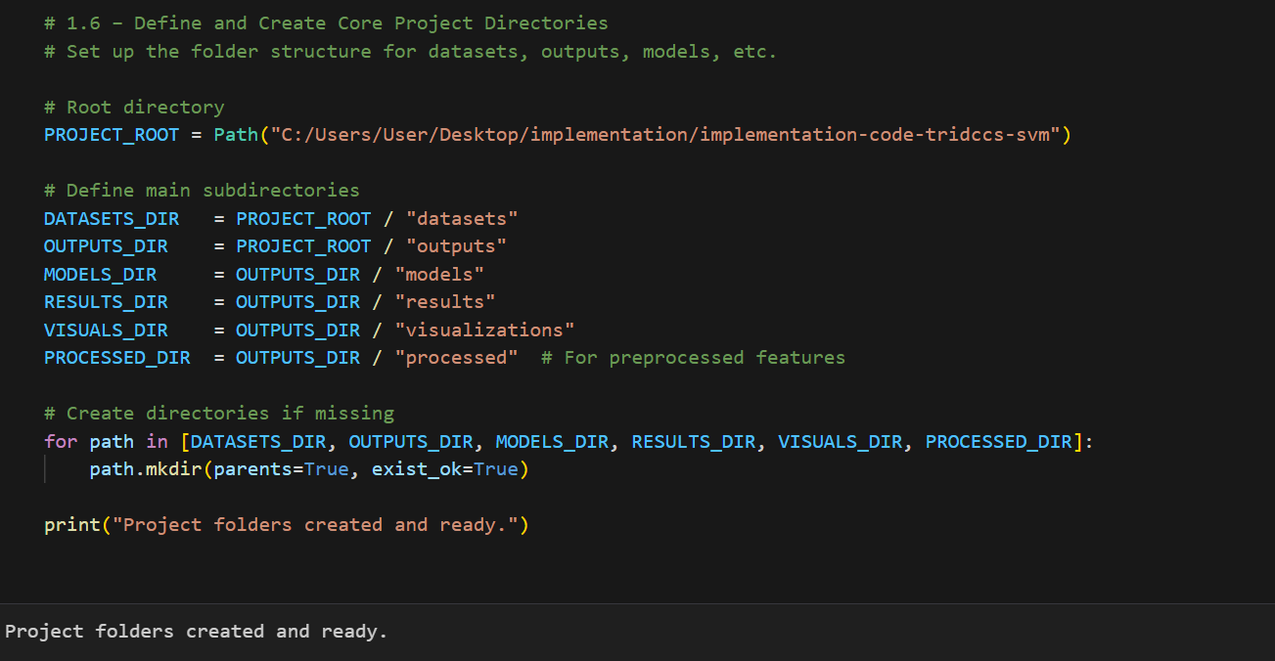
Directory Setup

Slide 15
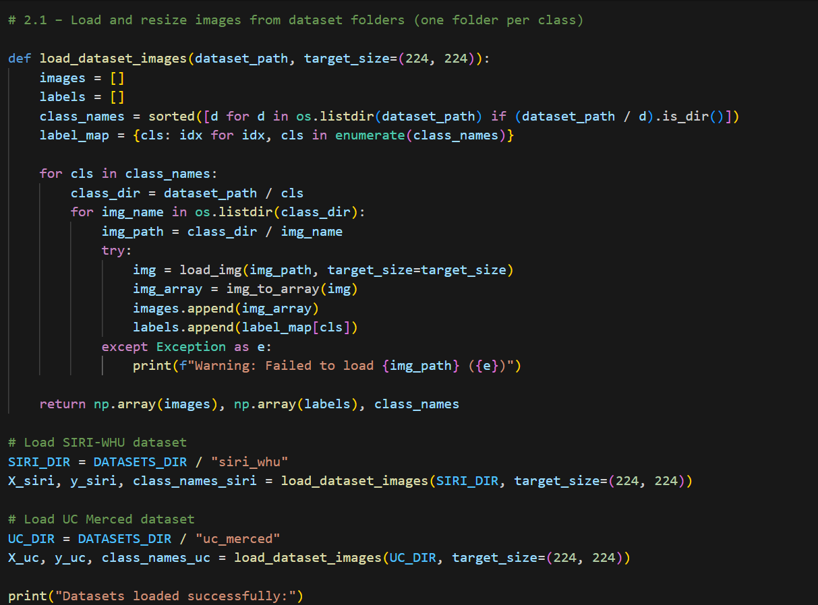
Dataset Loading
Output: Datasets loaded successfully:
SIRI-WHU dataset loaded: 2400 images, 12 classes UC Merced dataset loaded: 2100 images, 21 classes

Slide 16
Checking for Corrupt and Blank Images
Before training, datasets were validated for corrupt or blank images to ensure data quality.
A custom function was implemented using OpenCV to scan each image:
Detects unreadable (corrupt) images.
Flags near-black images with negligible pixel intensity.
Findings:
SIRI-WHU Dataset: No corrupt or blank images detected.
UC Merced Dataset: No corrupt or blank images detected.
Both datasets are clean and ready for training without data loss.

Slide 17
Splitting Datasets into Train/Test Sets
Datasets were split into 80% training and 20% testing, maintaining class balance (stratified split).
Random seeds ensured reproducibility:
SIRI-WHU → random_state=20
UC Merced → random_state=42
Results: SIRI-WHU Split:
Training: 1,920 images (12 classes).
Testing: 480 images (12 classes).
Results: UC Merced Split:
Training: 1,680 images (21 classes).
Testing: 420 images (21 classes).
> Class Distribution Example (SIRI-WHU – Train):
agriculture : 160 samples
commercial : 160 samples
...
water : 160 samples

Slide 18
Loading Pretrained CNN Models
Three pretrained CNN architectures were loaded for feature extraction:
ResNet50: 2048-dimensional features.
DenseNet169: 1664-dimensional features.
EfficientNetB0: 1280-dimensional features.
All models were loaded without their top layers and configured with Global Average Pooling to produce compact feature vectors.
> Output Shapes (after pooling):
ResNet50 → (None, 2048)
DenseNet169 → (None, 1664)
EfficientNetB0 → (None, 1280)
This dimensionality was later fused for classification

Slide 19
CNN Feature Summary and Fusion
Feature Dimensions Table:
Model | Output Dimension | Cumulative Dimension
ResNet50 | 2048 | 2048
DenseNet169 | 1664 | 3712
EfficientNetB0 | 1280 | 4992
Features from all three networks are concatenated to form a single representation of size 4992.

Slide 20
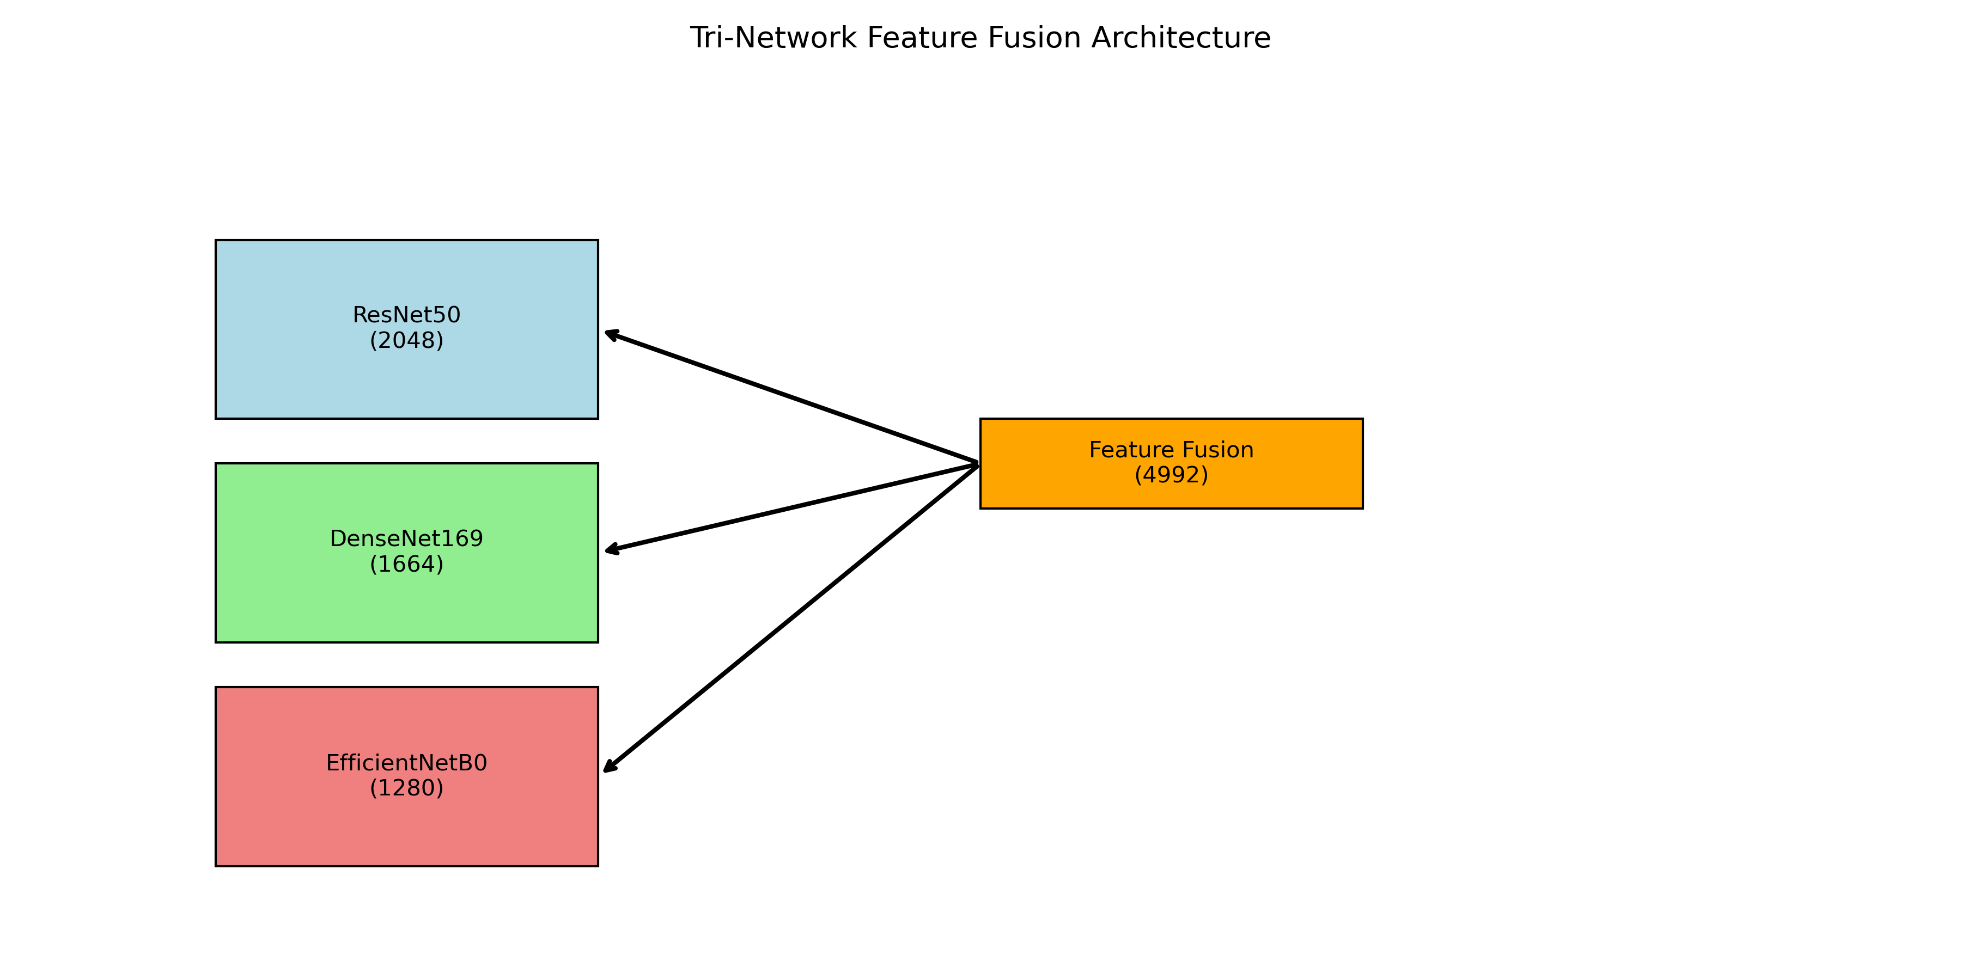
Figure 7: A fusion diagram illustrates how features from ResNet, DenseNet, and EfficientNet are combined into a unified vector.

Slide 21
Preprocessing & Feature Extraction Overview
Preprocessing Notes:
ResNet50: Converts RGB to BGR and subtracts mean pixel values.
DenseNet169: Normalizes pixel values to [0, 1] range.
EfficientNetB0: Scales pixel values to [-1, 1] range.
> These steps are applied automatically during feature extraction inside extract_features().
Key Point: The preprocessing ensures each CNN receives data in the optimal format for extracting meaningful deep features.

Slide 22
Feature Extraction and Scaling for SIRI-WHU & UC Merced
Features were extracted from each pretrained CNN (ResNet50, DenseNet169, EfficientNetB0):
SIRI-WHU:
Training Set: 1,920 samples
Testing Set: 480 samples
UC Merced:
Training Set: 1,680 samples
Testing Set: 420 samples
Feature Dimensions:
ResNet50 → 2048
DenseNet169 → 1664
EfficientNetB0 → 1280
Scaling Applied: StandardScaler (ensures zero-mean and unit-variance features) used to normalize features for improved SVM classification performance.
> Result: All CNN outputs were successfully extracted and scaled for both datasets.

Slide 23
Correlation Between CNN Feature Sets
Purpose of Analysis: Evaluate the degree of similarity between feature representations extracted from different CNNs.
Lower correlation → more complementary features → better fusion results.
Correlation Results (SIRI-WHU):
ResNet50 vs DenseNet169: 0.0132
ResNet50 vs EfficientNetB0: 0.0291
DenseNet169 vs EfficientNetB0: 0.0122
Correlation Results (UC Merced):
ResNet50 vs DenseNet169: 0.0237
ResNet50 vs EfficientNetB0: 0.0392
DenseNet169 vs EfficientNetB0: 0.0215
Key Insight: low correlation values confirm that each CNN learns unique and complementary features.

Slide 24
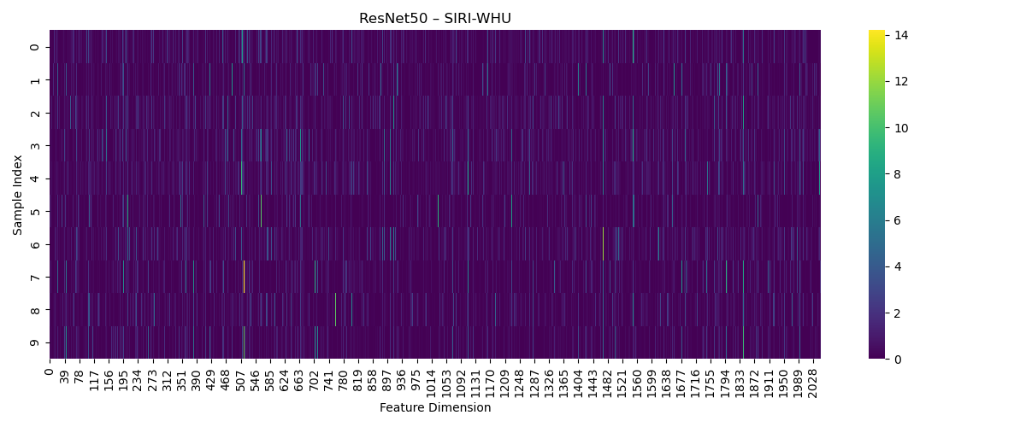
Heatmaps of CNN Feature Representations
Key Observation:
Heatmaps provide a visual summary of feature activations across all samples and dimensions.
Individual CNN heatmaps show distinct feature activations.
Fused feature heatmaps combine these activations into a comprehensive representation.
> Outputs: Heatmaps saved under : outputs/visualizations/

Slide 25
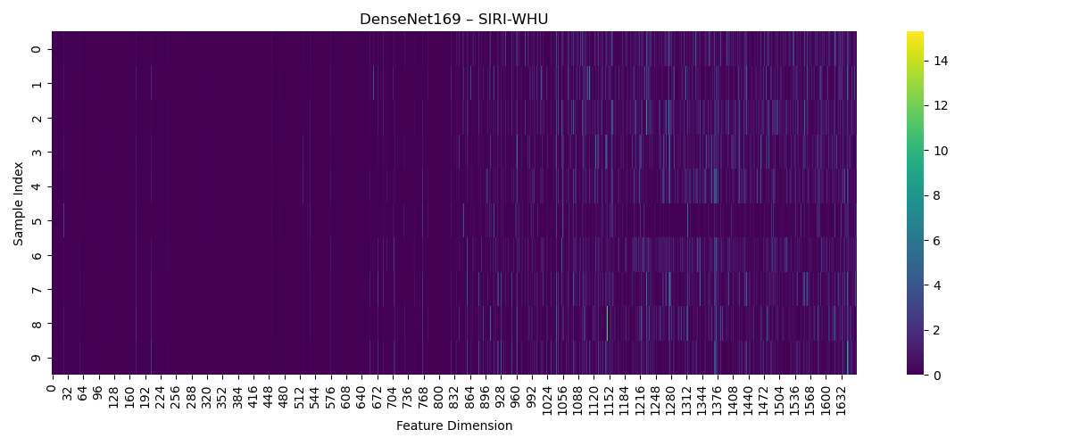
Heatmaps of CNN Feature Representations
Key Observation:
Individual CNN heatmaps show distinct feature activations.
Fused feature heatmaps combine these activations into a comprehensive representation.
> Outputs: Heatmaps saved under : outputs/visualizations/

Slide 26
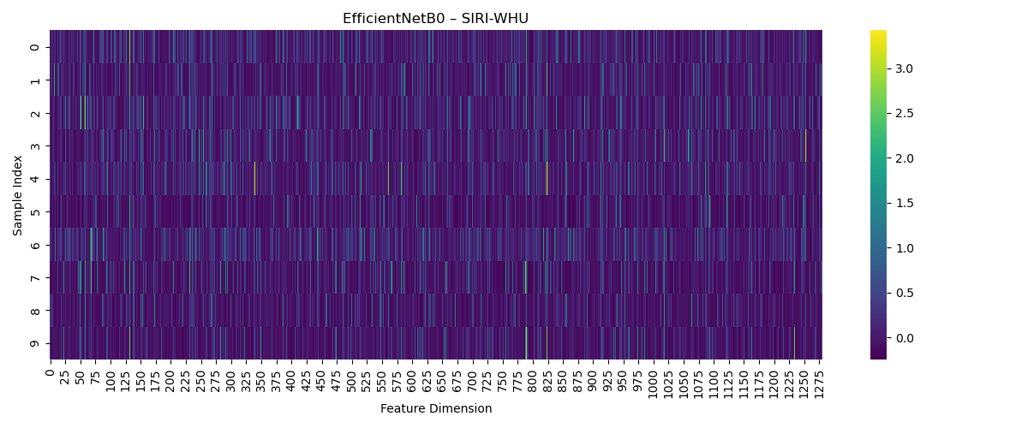
Heatmaps of CNN Feature Representations
Key Observation:
Individual CNN heatmaps show distinct feature activations.
Fused feature heatmaps combine these activations into a comprehensive representation.
> Outputs: Heatmaps saved under : outputs/visualizations/

Slide 27

Heatmaps of CNN Feature Representations
Key Observation:
Individual CNN heatmaps show distinct feature activations.
Fused feature heatmaps combine these activations into a comprehensive representation.
> Outputs: Heatmaps saved under : outputs/visualizations/

Slide 28

Heatmaps of CNN Feature Representations
Key Observation:
Individual CNN heatmaps show distinct feature activations.
Fused feature heatmaps combine these activations into a comprehensive representation.
> Outputs: Heatmaps saved under : outputs/visualizations/

Slide 29

Heatmaps of CNN Feature Representations
Key Observation:
Individual CNN heatmaps show distinct feature activations.
Fused feature heatmaps combine these activations into a comprehensive representation.
> Outputs: Heatmaps saved under : outputs/visualizations/

Slide 30
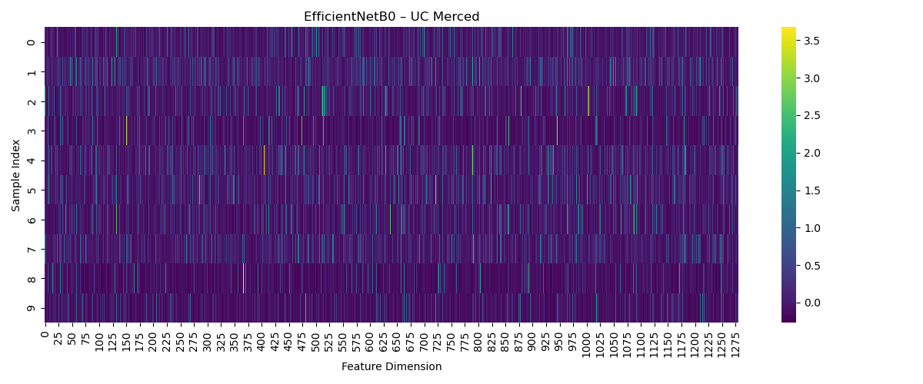
Heatmaps of CNN Feature Representations
Key Observation:
Individual CNN heatmaps show distinct feature activations.
Fused feature heatmaps combine these activations into a comprehensive representation.
> Outputs: Heatmaps saved under : outputs/visualizations/

Slide 31

Heatmaps of CNN Feature Representations
Key Observation:
Individual CNN heatmaps show distinct feature activations.
Fused feature heatmaps combine these activations into a comprehensive representation.
> Outputs: Heatmaps saved under : outputs/visualizations/

Slide 32
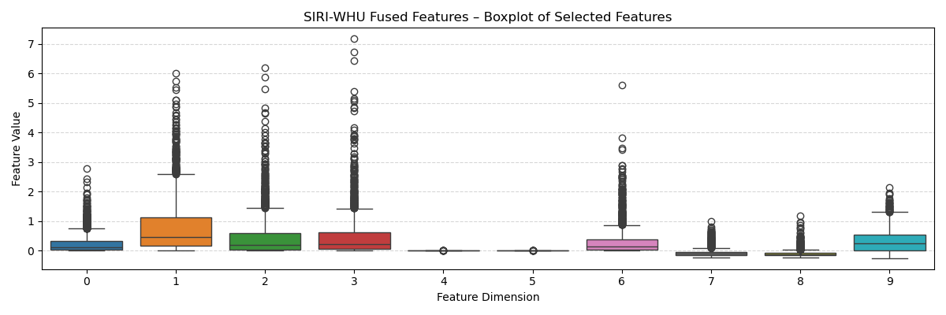
Fused Feature Distribution – Boxplots
Visualize how fused features are distributed across selected dimensions to check for outliers and variability.
Boxplots show variations in feature values and help identify dimensions with potential outliers.
Boxplot saved under: outputs/visualizations/

Slide 33
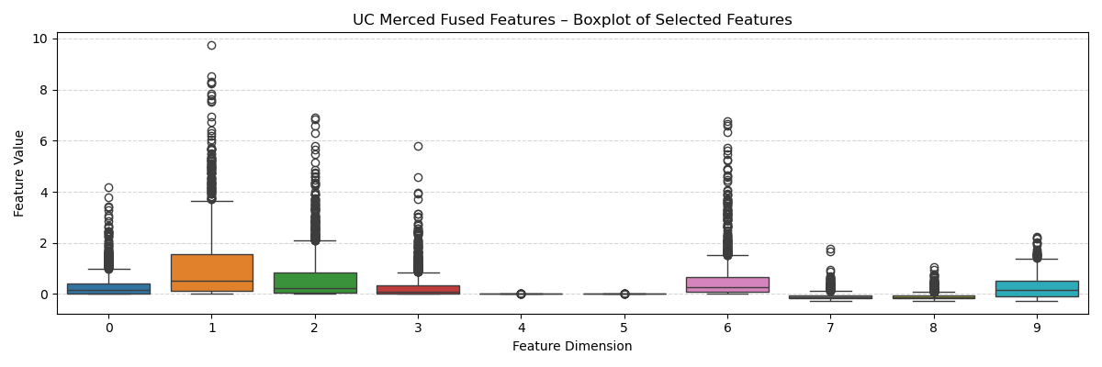
Fused Feature Distribution – Boxplots
Visualize how fused features are distributed across selected dimensions to check for outliers and variability.
Boxplots show variations in feature values and help identify dimensions with potential outliers.
Boxplot saved under: outputs/visualizations/

Slide 34
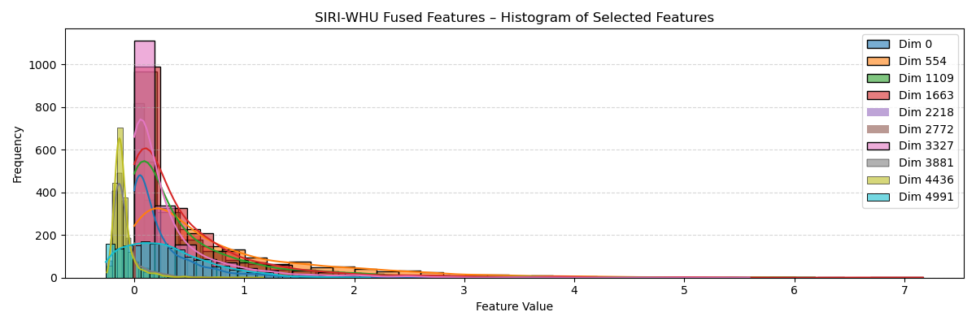
Fused Feature Distribution – Histograms
Provide frequency distribution of selected feature dimensions to understand data spread and density.
Histograms display normalized feature values and highlight dominant value ranges.
Boxplot saved under: outputs/visualizations/

Slide 35
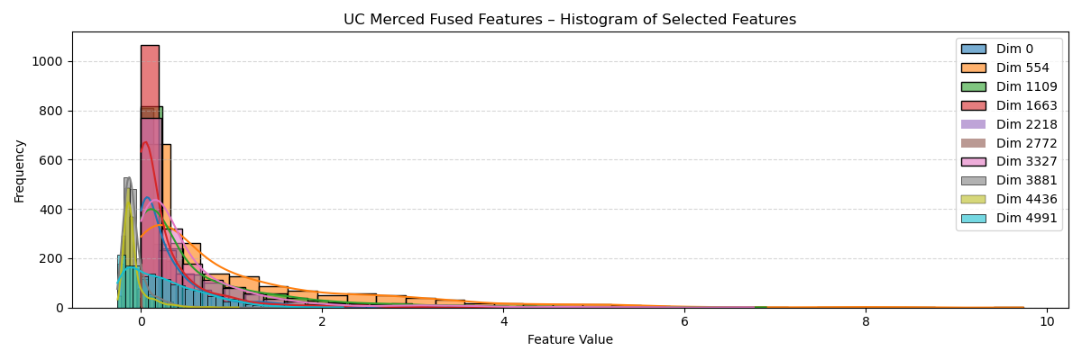
Fused Feature Distribution – Histograms
Provide frequency distribution of selected feature dimensions to understand data spread and density.
Histograms display normalized feature values and highlight dominant value ranges.
Boxplot saved under: outputs/visualizations/

Slide 36
Saving Extracted Features for Reuse
Store extracted features from CNNs and their corresponding labels to avoid recomputation.
Saved ResNet50, DenseNet169, and EfficientNetB0 features for both training and testing sets.
Saved separately for SIRI-WHU and UC Merced datasets.
Format: .pkl files using joblib.
Example Saved Files:
resnet_train.pkl → shape: (1920, 2048)
densenet_test.pkl → shape: (480, 1664)
efficientnet_train.pkl → shape: (1920, 1280)

Slide 37
Training and Evaluating SVM Classifier on SIRI-WHU Dataset
Training Support Vector Machine (SVM) on fused CNN features to classify SIRI-WHU dataset.
Training Details:
Kernel: RBF
Hyperparameters: C=10, gamma=“scale”
Performance:
Overall Accuracy: 96.25%
Weighted F1-Score: 96.25%
Outputs:
Trained SVM Model
Predictions on Test Set
Evaluation Metrics

Slide 38
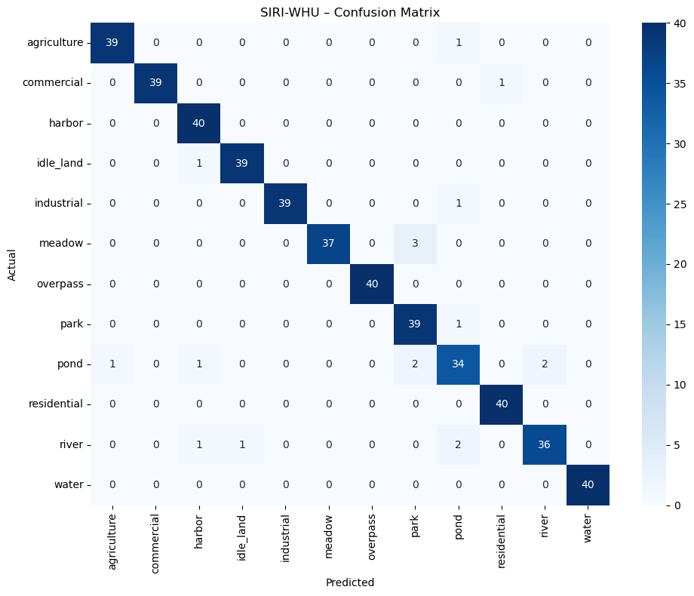
SIRI-WHU – Confusion Matrix
Visual heatmap of predicted vs actual classes.
Figure : SIRI-WHU Confusion Matrix (12 Classes)

Slide 39
Training and Evaluating SVM Classifier on UC Merced Dataset
Train Support Vector Machine (SVM) on fused CNN features for UC Merced dataset.
Training Details:
Kernel: RBF
Hyperparameters: C=10, gamma=“scale”
Performance:
Overall Accuracy: 97.86%
Weighted F1-Score: 97.85%
Outputs:
Trained SVM Model
Predictions on Test Set
Evaluation Metrics

Slide 40
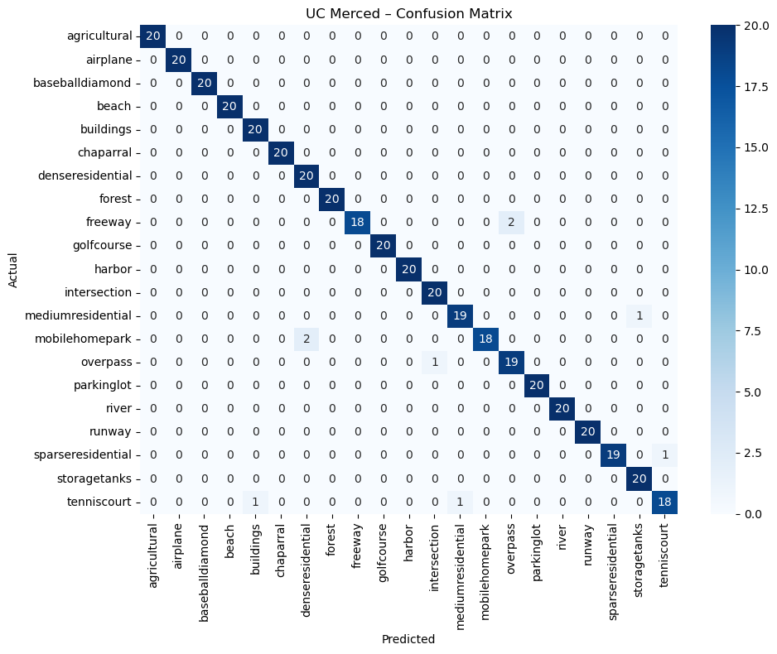
UC Merced – Confusion Matrix
Visual heatmap of predicted vs actual classes.
Figure : UC Merced Confusion Matrix (21 Classes)

Slide 41
Saving Trained Models for Future Use
Saved Models:
SVM Model (SIRI-WHU) → svm_model_siri_whu.pkl
SVM Model (UC Merced) → svm_model_uc_merced.pkl
Purpose of Saving:
Allow reuse without retraining
Support deployment or additional analysis
> All models saved under: outputs/models/svm/

Slide 42
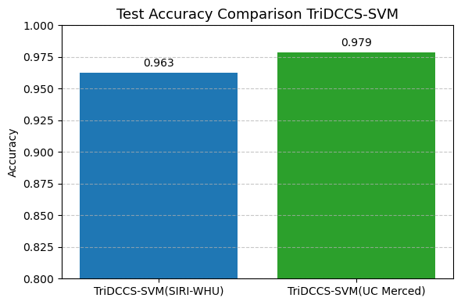
Final Test Accuracy: SIRI-WHU vs UC Merced
Figure : Test Accuracy: SIRI-WHU vs UC Merced

Slide 43
Detailed Per-Class Evaluation: SIRI-WHU
Metrics Computed for Each Class: Accuracy, Precision, Recall, F1-Score
Key Insights:
Most classes achieved ≥ 95% accuracy.
Minor variations in Pond and River classes due to intra-class variability.
 | Class | Accuracy | Precision | Recall | F1-Score
0 | agriculture | 0.975 | 0.9750 | 0.975 | 0.9750
1 | commercial | 0.975 | 1.0000 | 0.975 | 0.9873
2 | harbor | 1.000 | 0.9302 | 1.000 | 0.9639
3 | idle_land | 0.975 | 0.9750 | 0.975 | 0.9750
4 | industrial | 0.975 | 1.0000 | 0.975 | 0.9873
5 | meadow | 0.925 | 1.0000 | 0.925 | 0.9610
6 | overpass | 1.000 | 1.0000 | 1.000 | 1.0000
7 | park | 0.975 | 0.8864 | 0.975 | 0.9286
8 | pond | 0.850 | 0.8718 | 0.850 | 0.8608
9 | residential | 1.000 | 0.9756 | 1.000 | 0.9877
10 | river | 0.900 | 0.9474 | 0.900 | 0.9231
11 | water | 1.000 | 1.0000 | 1.000 | 1.0000
Table : Detailed Per-Class Evaluation

Slide 44
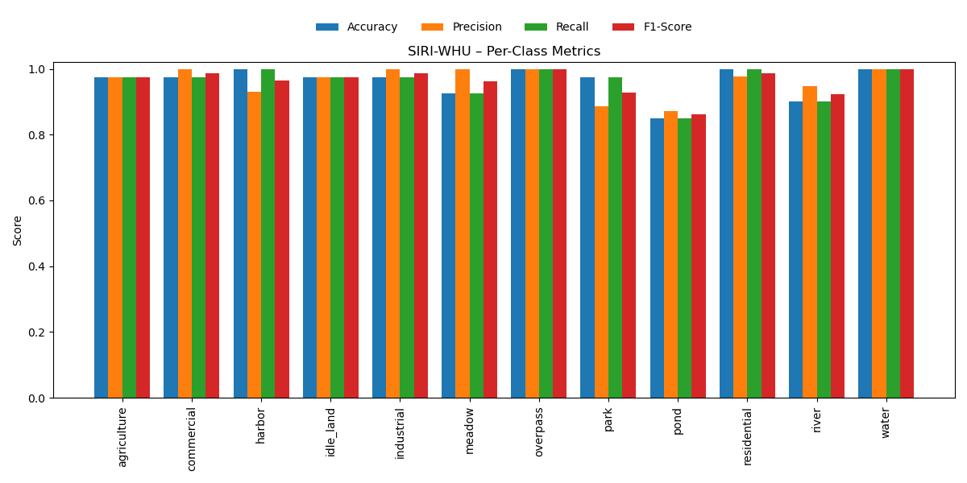
Detailed Per-Class Evaluation: SIRI-WHU
Figure : SIRI-WHU – Per-Class Metrics

Slide 45
Detailed Per-Class Evaluation: UC Merced
Metrics Computed for Each Class: Accuracy, Precision, Recall, F1-Score
Slight drops in freeway, tenniscourt, and mobilehomepark.
Class | Accuracy | Precision | Recall | F1-Score
0 | agricultural | 1.00 | 1.0000 | 1.00 | 1.0000
1 | airplane | 1.00 | 1.0000 | 1.00 | 1.0000
2 | baseballdiamond | 1.00 | 1.0000 | 1.00 | 1.0000
3 | beach | 1.00 | 1.0000 | 1.00 | 1.0000
4 | buildings | 1.00 | 0.9524 | 1.00 | 0.9756
5 | chaparral | 1.00 | 1.0000 | 1.00 | 1.0000
6 | denseresidential | 1.00 | 0.9091 | 1.00 | 0.9524
7 | forest | 1.00 | 1.0000 | 1.00 | 1.0000
8 | freeway | 0.90 | 1.0000 | 0.90 | 0.9474
9 | golfcourse | 1.00 | 1.0000 | 1.00 | 1.0000
10 | harbor | 1.00 | 1.0000 | 1.00 | 1.0000
11 | intersection | 1.00 | 0.9524 | 1.00 | 0.9756
12 | mediumresidential | 0.95 | 0.9500 | 0.95 | 0.9500
13 | mobilehomepark | 0.90 | 1.0000 | 0.90 | 0.9474
14 | overpass | 0.95 | 0.9048 | 0.95 | 0.9268
15 | parkinglot | 1.00 | 1.0000 | 1.00 | 1.0000
16 | river | 1.00 | 1.0000 | 1.00 | 1.0000
17 | runway | 1.00 | 1.0000 | 1.00 | 1.0000
18 | sparseresidential | 0.95 | 1.0000 | 0.95 | 0.9744
19 | storagetanks | 1.00 | 0.9524 | 1.00 | 0.9756
20 | tenniscourt | 0.90 | 0.9474 | 0.90 | 0.9231
Table : Detailed Per-Class Evaluation

Slide 46
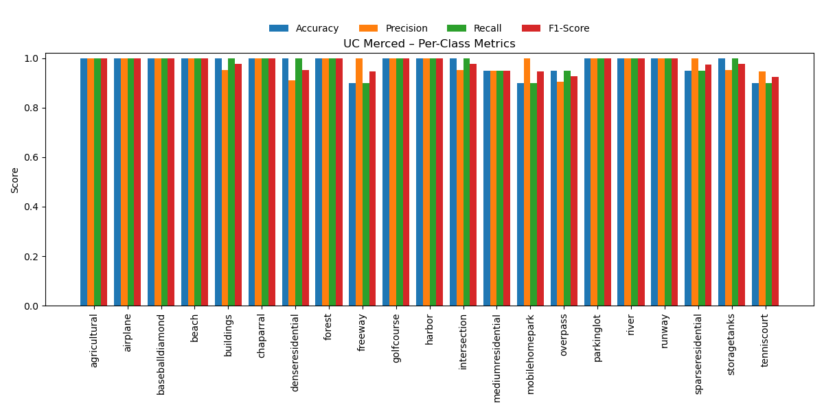
Detailed Per-Class Evaluation: UC Merced
Figure : UC Merced – Per-Class Metrics

Slide 47
Comparison of TriDCCS-SVM with Previous Studies

Slide 48
TriDCCS-SVM vs. VGG16-SVM (Tun et al., 2021)
Paper Title: Remote Sensing Data Classification Using a Hybrid Pre-Trained VGG16 CNN-SVM Classifier
(ElConRus 2021 | Nyan Linn Tun et al.)
Dataset Preparation
Split dataset (75% train / 25% test)
Extract feature maps
Load pre-trained VGG16 (ImageNet)
Train Linear SVM Classifier
Evaluate on UC Merced & RSSCN7 datasets
Methodology:
Pre-trained VGG16 for feature extraction.
SVM classifier for final prediction (Linear Kernel).
Hardware Specs:
Ryzen 5, GPU GTX 10703, 32GB RAM.
Datasets Used:
UC Merced Land Dataset
RSSCN7 Dataset
Reported Accuracy:
UC Merced → 87.71%
RSSCN7 → 95.24%
> TriDCCS-SVM:
Used 3 modern CNNs for richer and complementary features.
Feature Fusion → Captured diverse hierarchical representations.
Advanced SVM Kernel: Used RBF Kernel for better handling of non-linear separations.
Achieved Accuracy: UC Merced → 97.86% (+10.15% improvement) → SIRI-WHU → 96.25%
Figure : VGG-SVM classifier algorithm - Combining VGG16 with SVM

Slide 49
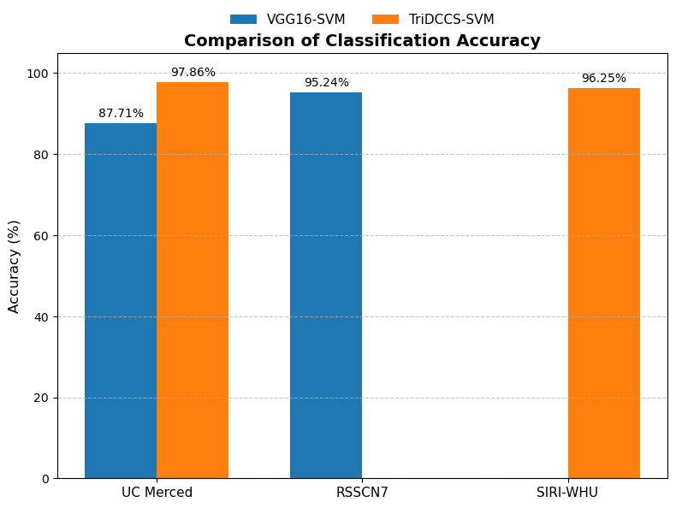
Comparison of Classification Accuracy: TriDCCS-SVM vs. VGG16-SVM (Tun et al., 2021)
Dataset | VGG16-SVM (Tun et al., 2021) | TriDCCS-SVM
UC Merced | 87.71% | 97.86% (+10%)
RSSCN7 | 95.24% | -
SIRI-WHU | - | 96.25%
Table : Comparison of Classification Accuracy Between VGG16-SVM Models and TriDCCS-SVM
Figure : Comparison of Classification Accuracy: TriDCCS-SVM vs. VGG16-SVM

Slide 50
TriDCCS-SVM vs. Single CNN (Ramasamy et al., 2023)
Paper Title: Investment of Classic Deep CNNs and SVM for Classifying Remote Sensing Images
(Advances in Electrical and Computer Engineering)
Methodology:
Transfer Learning approach using three pre-trained models (VGG16, ResNet50, DenseNet121).
Fully Connected Layer for classification.
Data Augmentation techniques applied.
Hyperparameter tuning with Random Search.
Datasets Used:
UC Merced Land Dataset
RSS-CN7 Dataset
Reported Accuracy:
Dataset Preparation
Add Fully Connected Layer
Extract features
Load pre-trained CNN (ImageNet)
Hyperparameter Tuning + Data Augmentation
Evaluate on UC Merced & RSS-CN7 Datasets
Model | UC Merced | RSS-CN7
ResNet50 | 91.72% | 88.06%
DenseNet121 | 93.19% | 89.82%
VGG16 | 95.88% | 91.26%
> TriDCCS-SVM:
Used three modern CNNs and performed feature fusion.
Applied advanced SVM (RBF kernel).
Achieved Accuracy: - UC Merced → 97.86% (+1.98%, +4.67%, +6.14% over VGG16, DenseNet121, ResNet50). - SIRI-WHU → 96.25% (+2.05%, +3.65%, +0.45% over DenseNet121, VGG16, ResNet50).
Figure : Single CNN Models Workflow

Slide 51
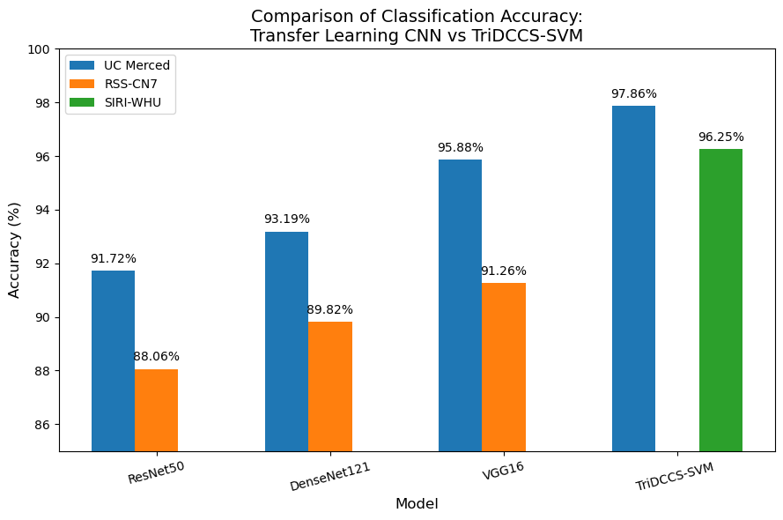
Comparison of Classification Accuracy: TriDCCS-SVM vs. Single CNN (Ramasamy et al., 2023)
Model | UC_Merced (%) | RSS-CN7 (%) | SIRI-WHU (%)
ResNet50 | 91.72 | 88.06 | -
DenseNet121 | 93.19 | 89.82 | -
VGG16 | 95.88 | 91.26 | -
TriDCCS-SVM | 97.86 | - | 96.25
Table : Comparison of Classification Accuracy Between CNN Models and TriDCCS-SVM
Figure : Comparison of Classification Accuracy: TriDCCS-SVM vs. Single CNN (Ramasamy et al., 2023)

Slide 52
TriDCCS-SVM vs. Single CNN-SVM (AlAfandy et al., 2020)
Paper Title: Investment of Classic Deep CNNs and SVM for Classifying Remote Sensing Images
(Advances in Science, Technology and Engineering Systems Journal)
Methodology:
Pre-trained CNN for feature extraction
SVM classifier for final prediction.
Hardware Specs:
Google Colab: 2-core Xeon CPU, Tesla K80 GPU (12GB), 13GB RAM.
Datasets Used:
UC Merced Land Dataset
SIRI-WHU Dataset.
Reported Accuracy:
Dataset Preparation
Split dataset (75% train / 25% test)
Extract features
Load pre-trained CNN (ImageNet)
Train SVM Classifier
Evaluate on UC Merced & SIRI-WHU Dataset
Model | UC Merced | SIRI-WHU
DenseNet-SVM | 90.20% | 94.20%
VGG16-SVM | 88.10% | 92.60%
ResNet50-SVM | 90.40% | 95.80%
> TriDCCS-SVM:
Used three modern CNNs and performed feature fusion.
Applied advanced SVM (RBF kernel).
Achieved Accuracy: - UC Merced → 97.86% (+7.66%, +9.76%, +7.46% over DenseNet-SVM, VGG16-SVM, ResNet50-SVM). - SIRI-WHU → 96.25% (+2.05%, +3.65%, +0.45% over DenseNet-SVM, VGG16-SVM, ResNet50-SVM).
Figure : Single CNN-SVM model Workflow

Slide 53
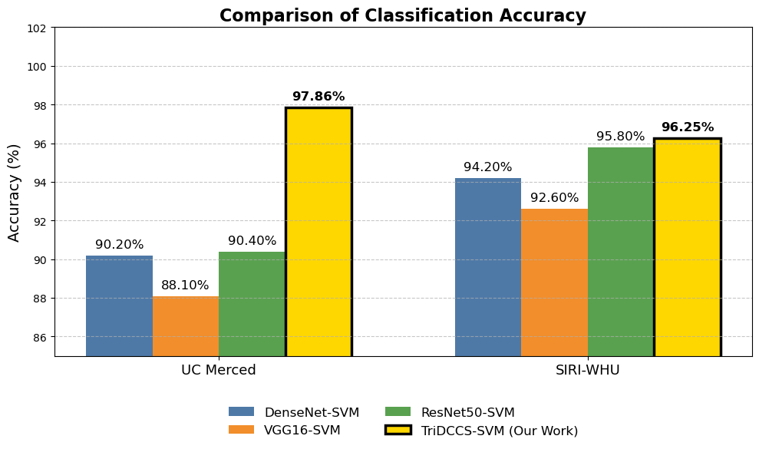
Comparison of Classification Accuracy: TriDCCS-SVM vs. Single CNN-SVM
Dataset | DenseNet-SVM | VGG16-SVM | ResNet50-SVM | TriDCCS-SVM
UC Merced | 90.20% | 88.10% | 90.40% | 97.86%
SIRI-WHU | 94.20% | 92.60% | 95.80% | 96.25%
Table : Comparison of Classification Accuracy Between Single CNN-SVM Models and TriDCCS-SVM
Figure : Comparison of Classification Accuracy

Slide 54
TriDCCS-SVM vs. AlexNet CNN (Shafaey et al., 2019)
Paper Title: Deep Learning for Satellite Image Classification
(AISI 2018 | Mayar A. Shafaey et al.)
Dataset Preparation
Extract mid-level features (fc7)
Load pre-trained AlexNet (ImageNet)
Resize images (227×227)
Train Multiclass SVM Classifier
Evaluate on UC Merced dataset
Methodology:
Pre-trained AlexNet CNN for feature extraction.
Multiclass SVM classifier for final prediction.
Hardware Specs:
Machine 1: Intel i7-2670QM @ 2.20GHz, 8GB RAM.
Machine 2: Intel i7-7700HQ @ 2.20GHz, GPU GTX 1050, 16GB RAM.
Datasets Used: UC Merced Land Dataset
Reported Accuracy: AlexNet CNN: 94%
> TriDCCS-SVM:
Used three modern CNNs for richer and complementary features.
Feature Fusion → Captured diverse hierarchical representations.
Advanced SVM Kernel: Used RBF Kernel for better handling of non-linear separations.
Achieved Accuracy: UC Merced → 97.86% (+3.86% improvement), SIRI-WHU →96.25%
Figure : AlexNet-CNN classifier model Combining CNN with SVM

Slide 55
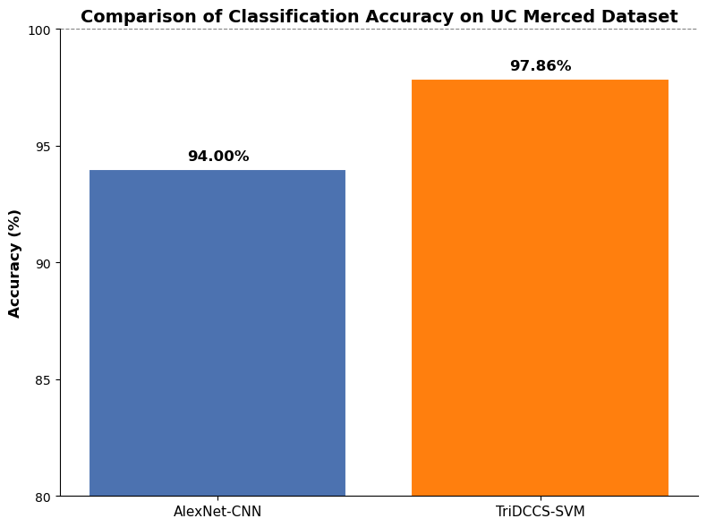
Comparison of Classification Accuracy: TriDCCS-SVM vs. AlexNet-CNN (Shafaey et al., 2019)
Dataset | AlexNet-CNN) | TriDCCS-SVM
UC Merced | 94.0% | 97.86% (+3.86%)
Table : Classification Accuracy on UC Merced Dataset
Figure : Comparison of Classification Accuracy between AlexNet-CNN and TriDCCS-SVM

Slide 56
TriDCCS-SVM vs. Lightweight CNN (Dwivedi et al., 2022)
Paper Title: Lightweight Convolutional Neural Network for Land Use Image Classification
(JAGST 2022 | Dwijendra N. Dwivedi & Ganesh Patil)
Dataset Preparation
Train Lightweight CNN Model
Configure Lightweight CNN Architecture
Image Preprocessing (Normalization)
Evaluate on UC Merced Dataset
Compare with State-of-the-Art Models
Methodology:
Developed a lightweight CNN for land use classification.
Used dropout, improved normalization, and optimized convolution/max-pooling layers.
Hardware Specs:
Intel Core i7 CPU, GPU unspecified, RAM: 16GB.
Datasets Used: UC Merced Land Dataset
Reported Accuracy: UC Merced: 88.29%
> TriDCCS-SVM:
Used three modern CNNs for richer and complementary features.
Feature Fusion → Captured diverse hierarchical representations.
Advanced SVM Kernel: Used RBF Kernel for better handling of non-linear separations.
Achieved Accuracy: UC Merced :97.86% (+9.57% improvement).
Figure : Lightweight CNN classifier workflow

Slide 57
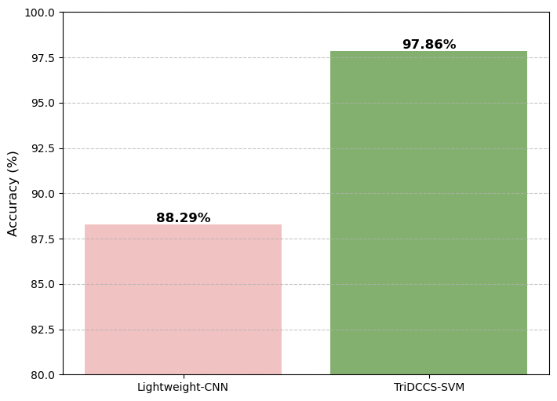
Comparison of Classification Accuracy: TriDCCS-SVM vs. Lightweight CNN (Dwivedi et al., 2022)
Dataset | Lightweight CNN | TriDCCS-SVM
UC Merced | 88.29% | 97.86% (+9.57%)
Table: Classification Accuracy Comparison
Figure : Comparison of Classification Accuracy

Slide 58
TriDCCS-SVM vs. CNN-FE, TL, Fine-Tuning (Alem et al., 2022)
Paper Title: Deep Learning Models Performance Evaluations for Remote Sensed Image Classification
(IEEE Access 2022 | Abebaw Alem & Shailender Kumar)
Methodology:
Developed three deep learning models for classification:
CNN-FE: Built from scratch.
TL: Transfer Learning using EfficientNetB7.
Fine-Tuning: Pre-trained EfficientNetB7 with all layers trainable.
Evaluated models using Accuracy, Precision, Recall, F1-Score, and Confusion Matrix.
Hardware Specs:
Intel Core i3-4000M @ 2.40 GHz, 4GB RAM (Google Colab Tesla K80 GPU).
Datasets Used: UC Merced Land Dataset
Reported Accuracy:
CNN-FE: 84.76%
Transfer Learning (TL): 87.90%
Fine-Tuning: 88.00%
Dataset Preparation
Fine-Tune EfficientNetB7
Build CNN-FE (Scratch) / Apply Transfer Learning
Preprocessing & Normalization
Evaluate with UC Merced Dataset
Compare Models using Accuracy, Precision, Recall, F1-Score
> TriDCCS-SVM:
Used three modern CNNs for richer and complementary features.
Feature Fusion → Captured diverse hierarchical representations.
Advanced SVM Kernel: Used RBF Kernel for better handling of non-linear separations.
Achieved Accuracy: UC Merced → 97.86% (+9.86% improvement).
Figure : Deep Learning Model workflow

Slide 59
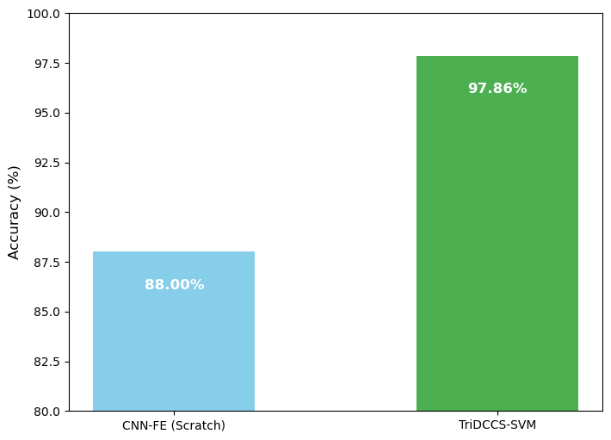
Comparison of Classification Accuracy: TriDCCS-SVM vs. CNN-FE, TL, Fine-Tuning (Alem et al., 2022)
Dataset | CNN-FE | Transfer Learning (TL) | Fine-Tuning | TriDCCS-SVM
UC Merced | 84.76% | 87.90% | 88.00% | 97.86% (+9.86%)
Table: Comparison of CNN-FE, TL, Fine-Tuning, and TriDCCS-SVM on UC Merced Dataset.
Figure : Comparison of Classification

Slide 60
TriDCCS-SVM vs. AlexNet, VGG16, VGG19 (Thirumaladevi et al., 2023)
Paper Title: Remote sensing image scene classification by transfer learning to augment the accuracy
(Measurement: Sensors, 2023 | S. Thirumaladevi et al.)
Methodology:
Extracted features independently from the fc7 layer of AlexNet, VGG16, and VGG19, and classified them separately using SVM.
Developed Transfer Learning models by replacing fully connected layers for classification.
Hardware Specs:
Workstation with GPU (Details not specified).
Datasets Used:
UC Merced Land Dataset.
SIRI-WHU Dataset.
Reported Accuracy
Dataset Preparation
2) Transfer Learning (Replace Fully Connected Layers, Fine-Tune Higher Layers)
1) Feature Extraction (Freeze CNN, Extract FC7 Features → Pass to SVM Classifier)
Single Pre-trained CNN (AlexNet OR VGG16 OR VGG19) - Frozen
Evaluation
Dataset | Network | Single pre-trained CNN + SVM (%) | Transfer Learning (%) | TriDCCS-SVM
UC Merced | AlexNet | 79.76 | 93.57
 | VGG19 | 81.19 | 94.08
 | VGG16 | 83.81 | 95.00% | 97.86% (+2.86%)
SIRI-WHU | AlexNet | 86.52 | 91.34
 | VGG19 | 87.60 | 92.78
 | VGG16 | 88.04 | 93.40% | 96.20% (+2.80%)
Figure : Deep Learning Model workflow
Table: Classification Accuracy Comparison

Slide 61
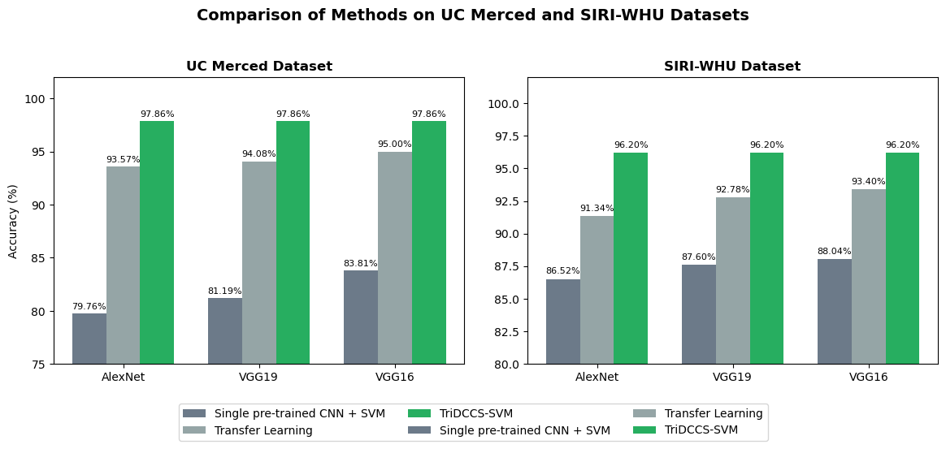
Comparison of Classification Accuracy: TriDCCS-SVM vs. VGG16, VGG19 (Thirumaladevi et al., 2023)
Figure : Comparison of classification accuracy between AlexNet, VGG16, VGG19 (Transfer Learning) and TriDCCS-SVM

Slide 62
Faculty of Science and Technology (FST)
2025

